Slide 1
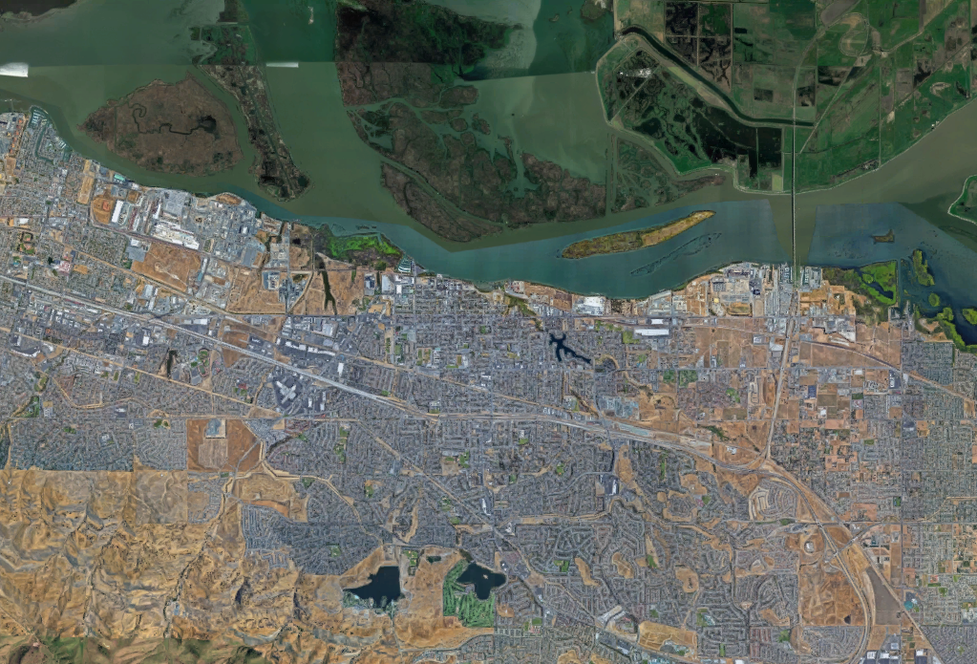
Brackish Water Desalination Project
Update to Antioch City Council
December 12, 2017
Notes:
Introduction
Background
Explain project
Scheduling issues
Critical council decisions – when will we be back toc
Acceptance of grants or loans
Certification EIR
Select Delivery Mechanism
Maps – where intake is relative to Delta
Map – concept of addition to treatment plant – all the things that are happening
One on pricing -here’s what you pay for water, here’s what this project could be at various capacity
Future decisions
Wrap up
Schedule fo conncil deciions
Overall schedule

Slide 2
Agenda
Project Background and Objectives
Project Overview
Accomplishments to Date
Funding Update
Schedule Update
Upcoming Council Decisions

Slide 3
City Water Supply
The City of Antioch treats and distributes raw water from the San Joaquin River utilizing its pre-1914 water rights and purchases raw water from the Contra Costa Water District when salinity at its intake is too high.

Slide 4
Value of City’s Water Rights is Being Eroded
Estimated Value of City Water Rights: $70-$100M
Changes in Delta Water Management: WaterFix
Cumulative Impacts of other projects degrading water quality in Western Delta
CCWD Settlement on WaterFix
Freeport
Development in San Joaquin Valley, etc.
Climate Change: Increasing Frequency of Droughts

Slide 5
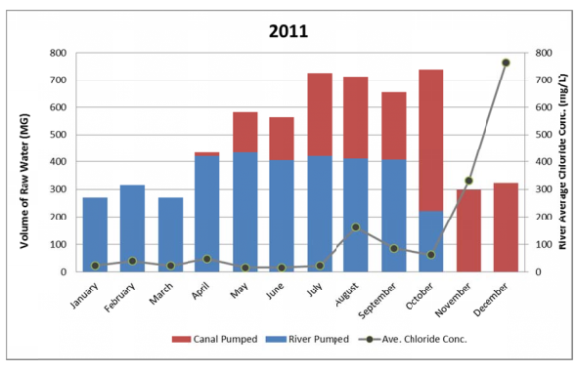
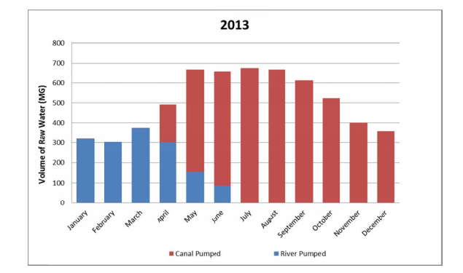
Increasing Salinity in Western Delta Forces City to Stop Using the River Earlier in Year
In typical non-drought years, 40% of the City’s supply comes from the San Joaquin River
In drought years, the City must switch to CCWD supply earlier. As little as 25% of the City’s supply may come from the San Joaquin River

Slide 6
3 Years Ago the City Began Investigating Brackish Water Project Opportunities
California in middle of 5yr drought
City needed to find ways to mitigate for WaterFix
Restore and maintain the value of the City’s water rights
Protect water quality and water reliability against future droughts
Provide flexibility for City’s needs and possible regional expansion
Provide environmental and economic benefits

Slide 7
Brackish Water Desalination is Cost-Effective
Tidal Delta water ~ 50 times less salty than seawater
One third the cost of seawater desalination
Current Cost of Antioch Finished Water
$1000/AF (CCWD raw water charge + treatment costs)
Estimated Water Cost Brackish Water Facility
$920 to $1,150/AF
Notes:
San Joaquin River water which has chloride levels 50 times lower than ocean water. This water is called “brackish” and can be treated to useable levels at 1/3 of the cost of ocean water desalination.

Slide 8
Project Overview
Treat 7.5MGD of brackish water to produce 6MGD finished water. Could be as much as 16MGD for a regional plant.
New river intake with state-of-the-art fish screens (incorporates existing CIP project)
Treatment facility at existing WTP site.
Current plan is to discharge at DDSD existing outfall (Antioch owns 50% capacity). Negotiations underway.

Slide 9
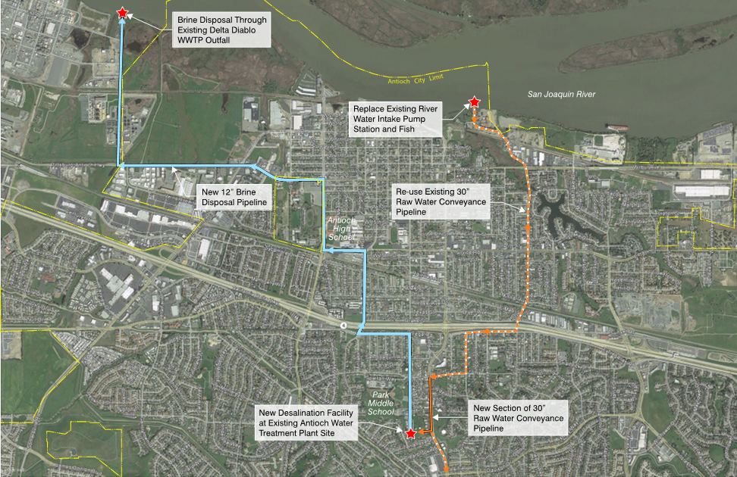
Brackish Water Project makes cost-effective use of existing facilities

Slide 10
Environmental and Economic Benefits
Improvements at the City’s intake would reduce its impact on the river. State-of-the-art fish screens and variable speed pumping provide net environmental fish benefits
New pumps will allow operational flexibility/efficiency in the timing and rate at which water is diverted
The more reliable a community’s water supply, the better the prospects for industrial and commercial growth (jobs)

Slide 11
Accomplishments to Date
Received $1M in State financing for planning effort
Preparing EIR
Developing project concepts and budgets
Evaluating alternative ways to deliver project
Pursuing outside funding – State grants and loans
Identifying potential regional partners

Slide 12
Funding Opportunities
Total cost of environmental certification, design and construction of this project is estimated to be $60M
Obtained: $1M low interest loan SWRCB State Revolving Fund program to cover the planning activities currently underway.
Applied: $10M Prop 1 Brackish Water Grant
(State limit for grants is $10M per project)
Future Potential: Up to $50M in State low interest loans specifically available for the brackish water project
Notes:
Could title something like: There are significant opportunities for project funding
On July 25, 2017, the City Council authorized the City Manager to submit an application to the California Department of Water Resources for grant funding up to $10,000,000 for the design and construction of the Brackish Water Desalination project from the Proposition 1 Water Desalination Grant Program.

Slide 13
Project Schedule
Environmental Review Underway
Public Scoping Period Aug-Sept 2017
Draft EIR under development
EIR for Council consideration Summer 2018
Preliminary Planning and Design Ongoing
Final Design and Permitting late 2018
Project Online late 2019/early 2020 depending on delivery method
Notes:
From AUGUST CIP UPDATE:
A Notice of Preparation of an Environmental Impact Report for this project was circulated from August 15, 2017 to September 14, 2017. This document was sent to the State Clearinghouse, Responsible and Trustee Agencies and other interested parties, and provided information describing the project and its potential environmental effects. A public scoping meeting was held on September 5, 2017 to discuss the proposed project and receive comments concerning the scope of the Environmental Impact Report. Staff is currently developing a draft Environmental Impact Report that is scheduled to be considered by the City Council in May of 2018 and design activity is expected to commence shortly thereafter. Final design and permitting of the project are programmed to be completed in September of 2018. Construction is anticipated to begin in late 2018 and be completed in December of 2019.

Slide 14
Upcoming City Council Decisions
Certify EIR
Select Preferred Project
Authorize acceptance of grants and loans from the state
Approve, if any, regional partnership agreements
Authorize proceeding with design and construction

